Slide 1

סמסטר סתיו תשפ”ג
Fall semester 2023
Hirsch Index Prediction
☞ Introduction to Data Science
☞ Lecturers: Dr. Naama Kopelman,
Dr. Jonathan Schler
Link to Slideshow
Matan Kichler • Oz Diamond

Slide 2
Abstract
The h-index is an author-level metric that measures both the productivity and citation impact of the publications, initially used for an individual scientist or scholar.
The h-index correlates with obvious success indicators such as winning the Nobel Prize, being accepted for research fellowships and holding positions at top universities.
Example
The h index is
3 because there
are at least 3
publications
with 3 citations
Publications of a scientist | Citations per publication
Publication No.1 | 3
Publication No.2 | 2
Publication No.3 | 21
Publication No.4 | 7

Slide 3




Abstract - cont.
While there’s an algorithm for calculating the h-index – we assume that with a given information about scientists we could predict their h-index as well with the using of some basic machine learning algorithms.
There are dozens of websites providing mass information about thousands of scientist among thousands of institutes

Slide 4

Scraping Data

Slide 5

Data Scraping
“Data scraping used for extracting data from websites. Web scraping software may directly access the World Wide Web using the Hypertext Transfer Protocol or a web browser.” ~wikipedia
We used both crawling and API. the crawling itself took about 3 days of gathering data with Selenium.
Dall E prompt given by Matan Kichler

Slide 6
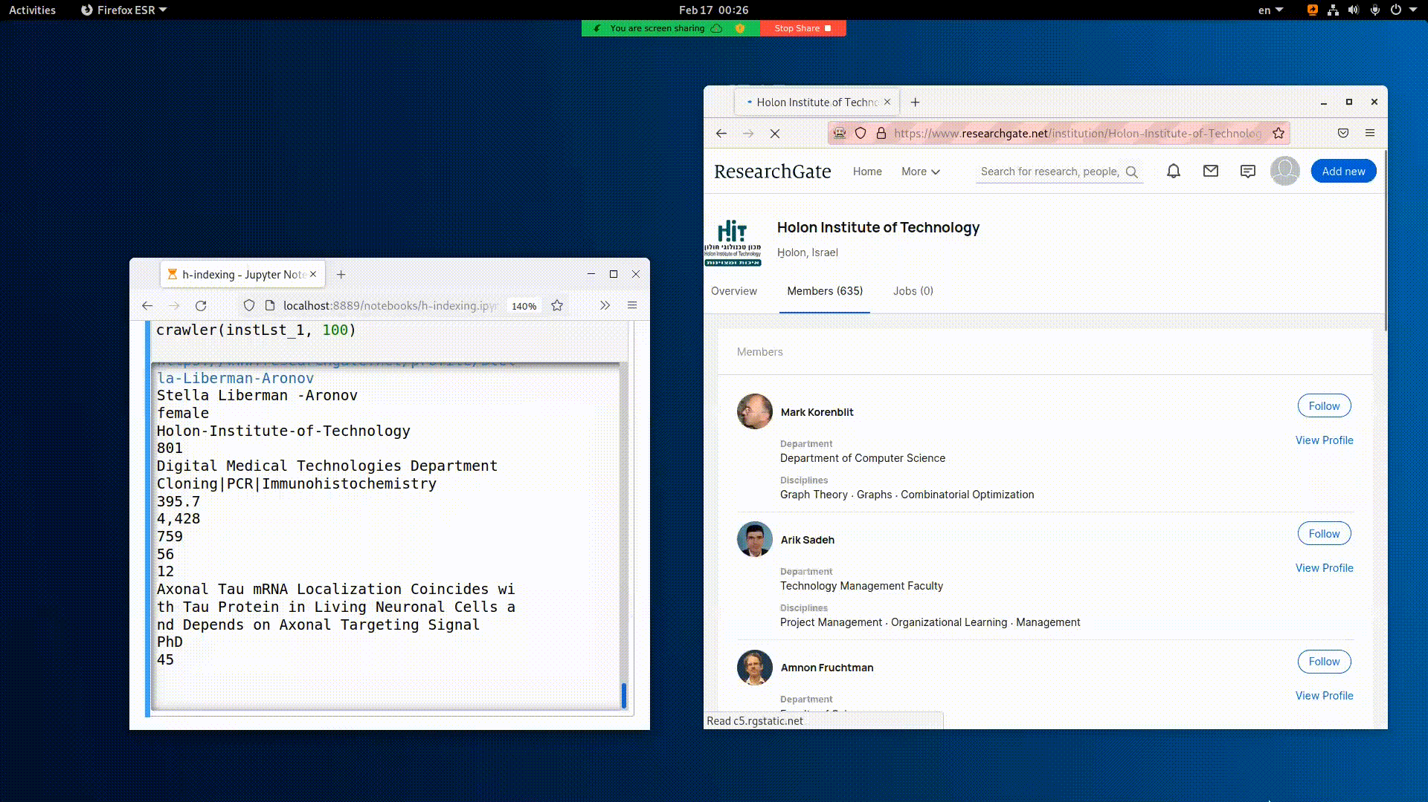

Slide 7
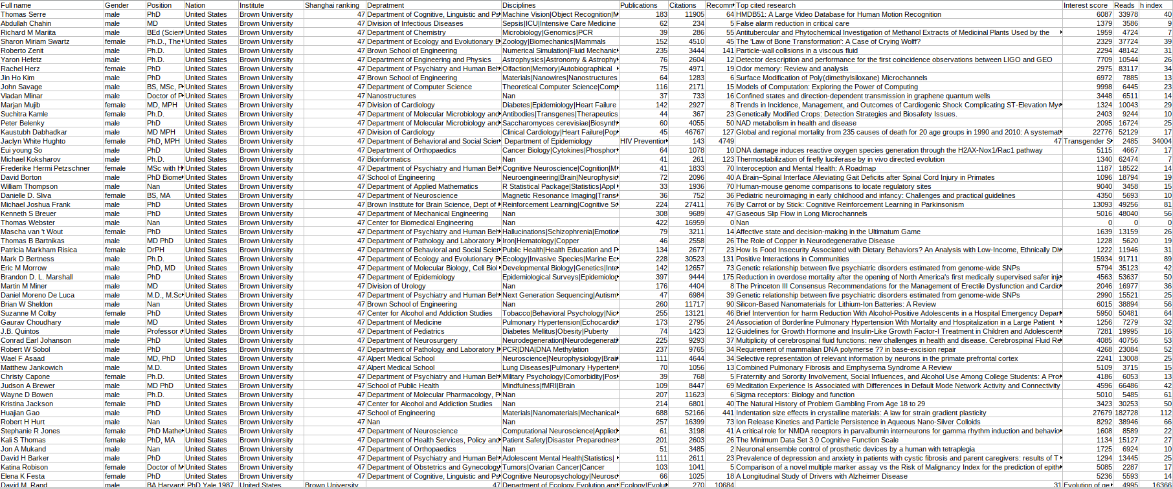
Web crawling - CSV output

Slide 8
Web crawling - CSV output
30,000+
scientists

Slide 9
Web crawling - CSV output
30,000+
scientists
☞ Female / Male achieved with an API requests and later with names-gender library

Slide 10
Web crawling - CSV output
30,000+
scientists
☞ Flaws

Slide 11
Data Cleansing

Slide 12

Data Cleansing
“the process of detecting and correcting corrupt or inaccurate records from a database and refers to identifying incomplete, incorrect, inaccurate or irrelevant parts of the data and then replacing, modifying, or deleting the dirty or coarse data.” ~wikipedia
Dall E prompt given by Matan Kichler
We had several kinds of flaws. First, we simply scrolled down the data-frame and categorizing the most obvious.
Later, we used advanced techniques such as boxplots, searching for outliers.

Slide 13
Data Cleansing cont.
Obvious data we chosen to remove:
Corrupts and flows
Rows with more than the expected columns
Rows with strings within numeric cells
E.g a word instead of digits within citations
Non scientist
0 publications, 0 citations, 0 reads...
Couldn’t determine gender
Names that wer’ent featured in the API
Duplicates

Slide 14
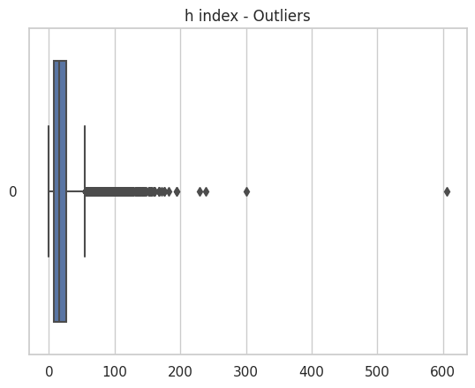
Data Cleansing cont.
Outliers

Slide 15




Data Cleansing cont.
Outliers
Dr. Cynthia Edenburg
Actual h index: 3
Prof. Walter C Willett
Actual h index: 300

Slide 16
Data Cleansing cont.
Outliers
Dr. Cynthia Edenburg
Actual h index: 3
Prof. Walter C Willett
Actual h index: 300

Slide 17
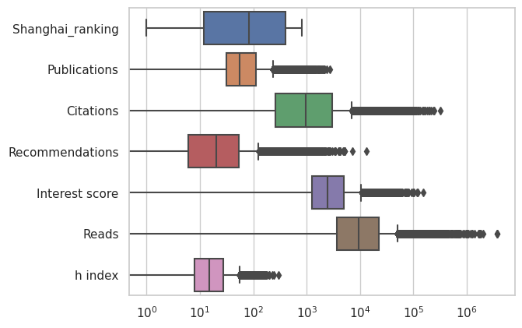
Data Cleansing cont.
Outliers
☞ Not outliers. Checked manually
☞ X axis was scaled logarithmically for better understanding

Slide 18
Exploratory Data Analysis

Slide 19

EDA
“An approach of analyzing data sets to summarize their main characteristics,
often using statistical graphics and other data visualization methods.” ~wikipedia
In this section we will discuss the relations between the features we collected and their impact on the h index score.
Dall E prompt given by Matan Kichler

Slide 20
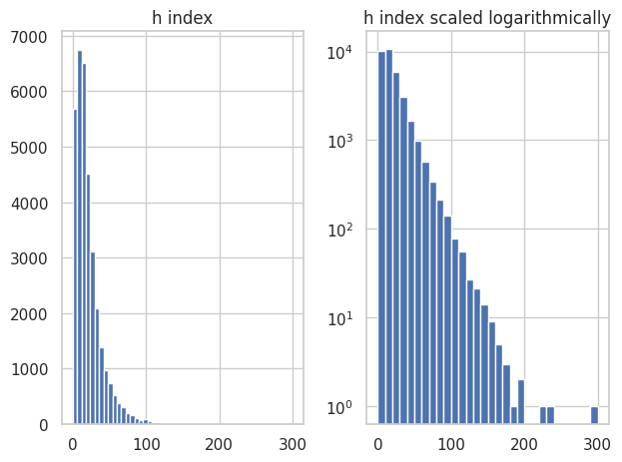
EDA cont.
After scaling the h index logarithmically, the decrease appeared to be linear.
We drew from this that the higher the h index is there are exponentially less people with that score.
Bars plot
☞ Y axis was scaled logarithmically

Slide 21
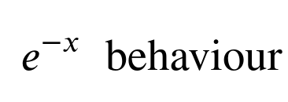
EDA cont.
After scaling the h index logarithmically, the decrease appeared to be linear.
We drew from this that the higher the h index is there are exponentially less people with that score.
☞ Missing data because we had collected top 1000 h index scientists of each institute + were removed in the cleansing part.
-x

Slide 22
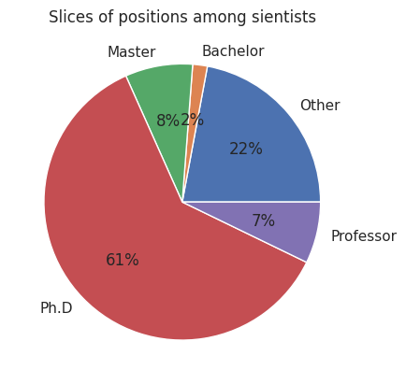
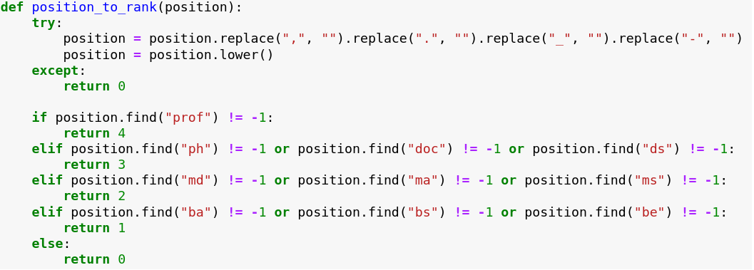
EDA cont.
Ffff
We added Position-rank categorical column ; professors received 4, Ph.D 3, Masters 2, Bachelors 1 and else 0.
☞ Weren’t declare their position or undergraduates.

Slide 23
EDA cont.
Ffff
Assumptions
Naturally there are much less professors than Ph.Ds.
Professors may retired very often due to their age, or may be less ambitious than young Ph.Ds.
Professors might be much more busy in lecturing, pedagogy and other activities rather than in researches.
People with Bachelor degreed represent only 2 percents of researchers. It does make sense, because naturally the may continue to their Master degree or leave the academic environment, rather than being involved in researches.
Most Master programs require conducting researches and submitting a thesis at the end of the program.

Slide 24
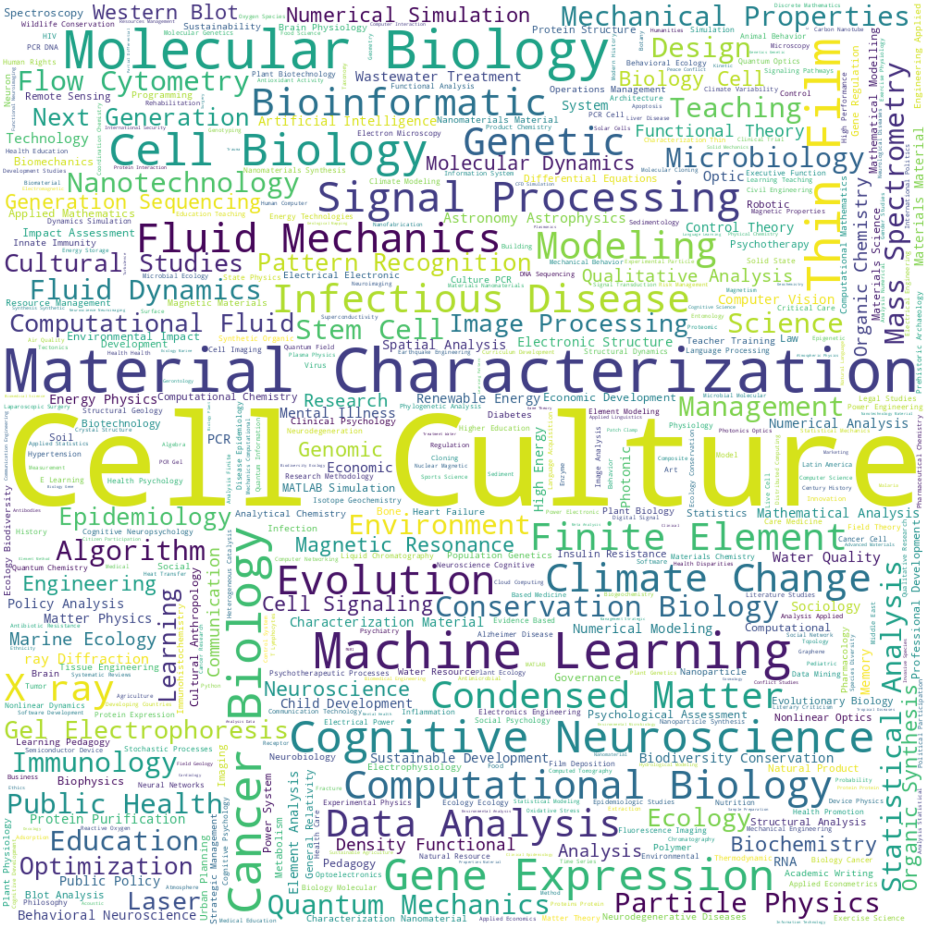

EDA cont.
Words cloud - Disciplines
>>>stylecloud.gen_stylecloud(file_path='SJ-Speech.txt', icon_name='fab fa-python', palette='colorbrewer.diverging.Spectral_11')

Slide 25
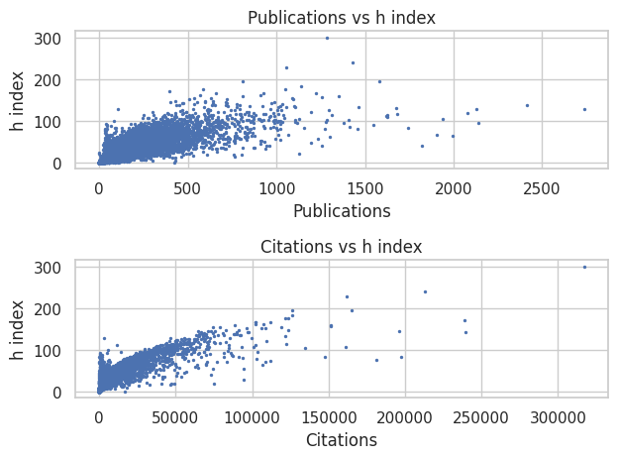
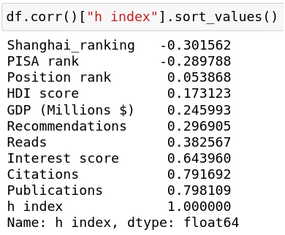
EDA cont.
Scatter plots
Publications and citation are the main and only factors to calculate the h index and indeed there is a strong correlation between them.
☞

Slide 26
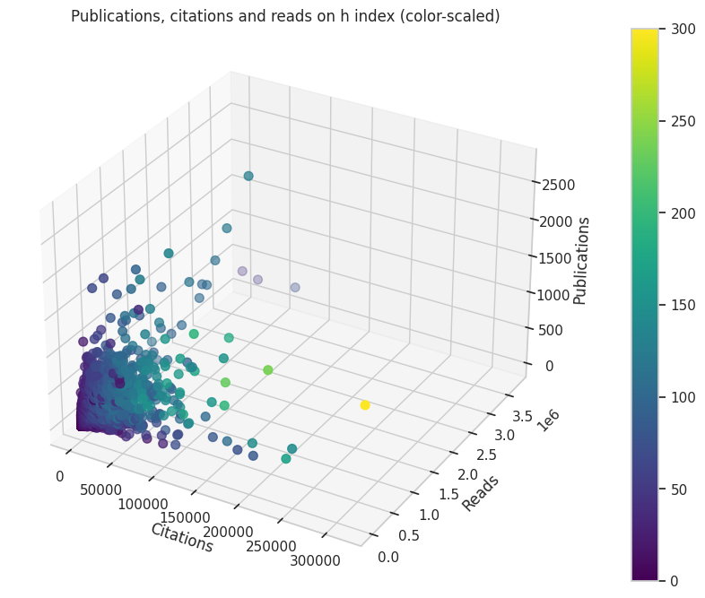
EDA cont.
Scatter plots
We added the ‘Reads’ factor and plot in 4D.
some scientists have very high h index although they published 'few' papers. That is probably because there are very few papers that reached wide-spread exposure.
Number of reads and h-index has moderate correlation as well.

Slide 27
EDA cont.
Scatter plots
we want the see what is the impact of the other parameters on the h index, and perhaps we could ‘invent’ a better index of predicting ones’ success.
We added the ‘Reads’ factor and plot in 4D.
some scientists have very high h index although they published 'few' papers. That is probably because there are very few papers that reached wide-spread exposure.
Number of reads and h-index has moderate correlation as well.

Slide 28
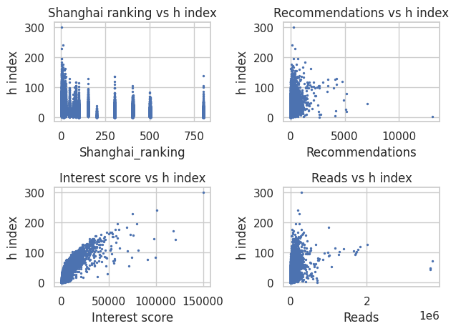
EDA cont.
Scatter plots

Slide 29
EDA cont.
Scatter plots
Poor graph
Instead, we’ll calculate the average h index per Shanghai ranking, and late the average h index for each nation.
We’ll add three more columns:
GDP of a nation in M$
HDI score of a nation
PISA rank of a nation

Slide 30
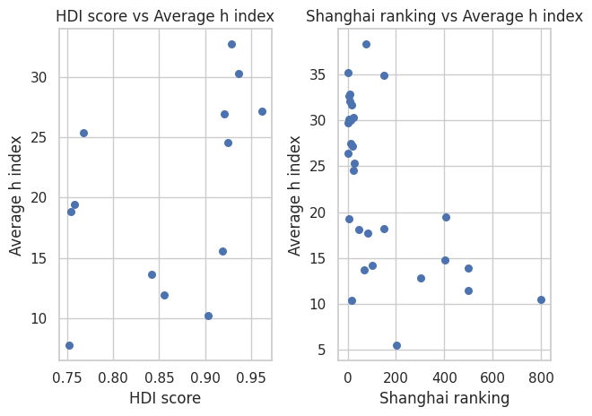
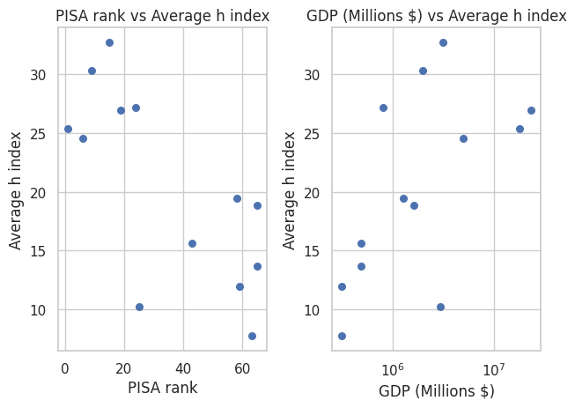
R-squared = 0.213
Pearson correlation coefficient = 0.462
R-squared = 0.343
Pearson correlation coefficient = -0.586
R-squared = 0.524
Pearson correlation coefficient = -0.724
R-squared = 0.157
Pearson correlation coefficient = 0.396

Slide 31
Most correlated
R-squared = 0.213
Pearson correlation coefficient = 0.462
R-squared = 0.343
Pearson correlation coefficient = -0.586
R-squared = 0.524
Pearson correlation coefficient = -0.724
R-squared = 0.157
Pearson correlation coefficient = 0.396
☞ It doesn’t matter much where you study. Prestige has a low impact.
☞ Primary education has a relatively strong correlation to academic success.
☞ Cash doesn’t produce good scientists.

Slide 32
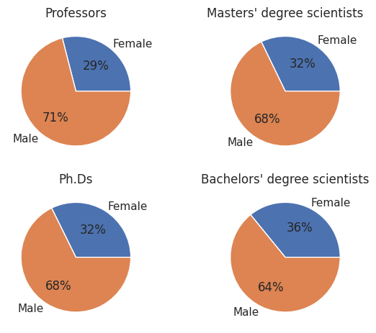
EDA cont.
Gender biases

Slide 33
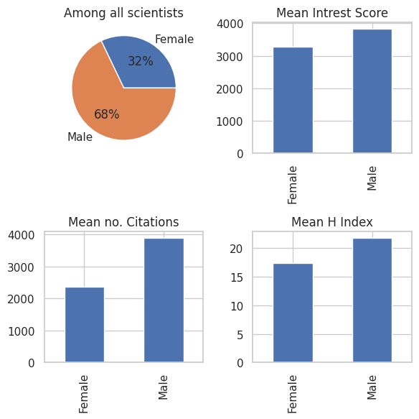
EDA cont.
Gender biases
Unfortunately, we witness that women are still underrepresented in many scientific fields in academia, especially in higher positions.
This is due to factors such as implicit bias, gender stereotypes, and lack of support.
Academic institutions and the scientific community need to work together to promote diversity, provide equal opportunities, and encourage young women to pursue science careers.

Slide 34
Machine learning models

Slide 35

Machine learning models
“A field of inquiry devoted to understanding and building methods that "learn" – that is, methods that leverage data to improve performance on some set of tasks.” ~wikipedia
We removed all the columns which are irrelevant for the model:
Gender -> convert to Female to 0 and Male to 1
remove 'Full name'
remove 'Position' (there’s ‘position rank’)
remove 'Nation'
remove 'Disciplines'
remove 'Department'
remove 'Institute' (only in linear regression)
remove 'Top cited research'
Dall E prompt given by Matan Kichler

Slide 36

Machine learning cont.
Models we were tested two models:
Linear regression
Random Forest
Other models s.a KNN or K-means are less relevant because that the predict of a h index is a regression problem and not a categorical one.
For the models we used the sklearn library

Slide 37
Linear Regression
Linear Regression is a statistical method that studies the relationship between different variables on data.
Since h index is given based on the number of publications and how many times each was cited and it being on a continuous scale it’s appropriate to use linear regression for our problem.
We split the dataset to train and test sets, removed all non continuous/ numeric features and scaled it using Min-Max scaler.
Our model yielded R2 score of over 78 percents

Slide 38
Random Forest
Decision trees are a type of supervised machine learning algorithm used for classification and regression analysis. They use a tree-like model of decisions and their possible consequences to make predictions or classifications.
Random Forest is a machine learning algorithm that combines multiple decision trees to make better predictions.
In a decision tree, the data is split based on a single feature at each node. However, a Random Forest uses multiple decision trees and randomly selects a subset of features for each tree. By doing so, it reduces overfitting and increases the diversity of the trees in the forest, which leads to better generalization performance.
When we performed this algorithm on our dataset with 10 estimators (trees in forest) which led to very poor fitting with accuracy score of 17 percents .
After removing some features and we witnessed a drastic increase in the performance of our model , resulting in accuracy score of over 88 percents.
Finally, we did a grid search (GridSearchCV) with different parameters to find an optimal combination resulting in over 93 percents fitting , 5.45 SSE score and R2 score of 98 percents

Slide 39
PCA - Principal component analysis
“Technique for analyzing large datasets containing a high number of dimensions/features per observation, increasing the interpretability of data while preserving the maximum amount of information.” ~wikipedia
We will try the use of PCA in order to increase the accuracy score of the linear regression from 78%.
Improvements attempts

Slide 40
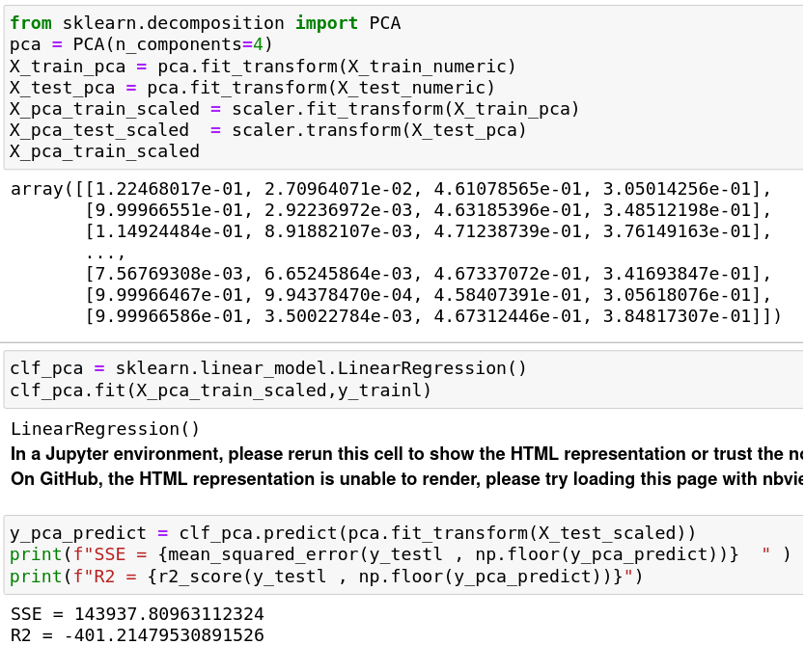
PCA cont.
We reduced the components to 4 and a receive negative R-squared of -401 which is clearly not improving the linear regression model.
Improvements attempts

Slide 41
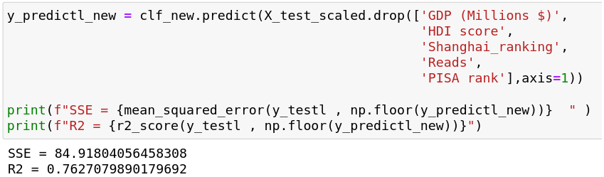
Reducing columns
We will try another attempt, manually removing columns which has lower correlation the the h index:
GDP
HDI score
Shanghai_ranking
Reads
PISA rank
Improvements attempts

Slide 42
Reducing columns
We will try another attempt, manually removing columns which has lower correlation the the h index:
GDP
HDI score
Shanghai_ranking
Reads
PISA rank
Improvements attempts
☞ It worsen our accuracy score from 0.78 to 0.76. Not an improvement.

Slide 43
Conclusions

Slide 44
Conclusions
(heuristic approach)
Whilst there are some features which are moderately correlated to the h index, a linear regression model, even with a medium accuracy, appear to be the optimal option available that doesn’t uses a neural network.
We could predict a close h index of a scientists to his actual, relying of his other features.
Additionally, we saw that there are gaps and biases among genders, and nations that suffer from poor education to nations with advanced education system, in producing successful scientist.

Slide 45


We will send our great lecturer Dr. Jonathan Schler into each of the model to see how his h index would be predicted on each.
We made sure Dr. Schler isn’t in the training set. We create a data frame of one row and concatenate him to the training set with the index -1.
Demonstration
Dr. Jonathan Schler
'Gender':'Male' ,
'Nation':'Israel',
'Institute':'Bar Ilan University',
'Shanghai_ranking':301,
'Publications':41 ,
'Citations':3689,
'Recommendations':5,
'Interest score':2067,
'Reads':31027 ,
'PISA rank':43,
'GDP (Millions $)':488527,
'HDI score':0.919,
'Position rank':3
Actual h index: 20

Slide 46
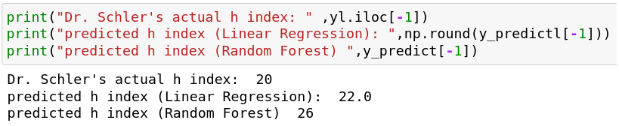
Demonstration
Dr. Jonathan Schler
Dr. Jonathan Schler
'Gender':'Male' ,
'Nation':'Israel',
'Institute':'Bar Ilan University',
'Shanghai_ranking':301,
'Publications':41 ,
'Citations':3689,
'Recommendations':5,
'Interest score':2067,
'Reads':31027 ,
'PISA rank':43,
'GDP (Millions $)':488527,
'HDI score':0.919,
'Position rank':3
'Gender':'Male' ,
'Nation':'Israel',
'Institute':'Bar Ilan University',
'Shanghai_ranking':301,
'Publications':41 ,
'Citations':3689,
'Recommendations':5,
'Interest score':2067,
'Reads':31027 ,
'PISA rank':43,
'GDP (Millions $)':488527,
'HDI score':0.919,
'Position rank':3
Actual h index: 20
Actual h index: 20
Random forest
Linear regression
Predicted:
26
Predicted:
22

Slide 47
Although the linear regression has an accuracy score of 78%, the predicted results, 22, is much more close to its actual score.
Whilst the random forest shows an accuracy of 98% which is almost perfect, but the score, 26, is far from its actual h index
Demonstration
Dr. Jonathan Schler
Dr. Jonathan Schler
'Gender':'Male' ,
'Nation':'Israel',
'Institute':'Bar Ilan University',
'Shanghai_ranking':301,
'Publications':41 ,
'Citations':3689,
'Recommendations':5,
'Interest score':2067,
'Reads':31027 ,
'PISA rank':43,
'GDP (Millions $)':488527,
'HDI score':0.919,
'Position rank':3
'Gender':'Male' ,
'Nation':'Israel',
'Institute':'Bar Ilan University',
'Shanghai_ranking':301,
'Publications':41 ,
'Citations':3689,
'Recommendations':5,
'Interest score':2067,
'Reads':31027 ,
'PISA rank':43,
'GDP (Millions $)':488527,
'HDI score':0.919,
'Position rank':3
Actual h index: 20
Actual h index: 20
Random forest
Linear regression
Predicted:
26
Predicted:
22

Slide 48
Although the linear regression has an accuracy score of 78%, the predicted results, 22, is much more close to its actual score.
Whilst the random forest shows an accuracy of 98% which is almost perfect, but the score, 26, is far from its actual h index
Demonstration
Dr. Jonathan Schler
Dr. Jonathan Schler
'Gender':'Male' ,
'Nation':'Israel',
'Institute':'Bar Ilan University',
'Shanghai_ranking':301,
'Publications':41 ,
'Citations':3689,
'Recommendations':5,
'Interest score':2067,
'Reads':31027 ,
'PISA rank':43,
'GDP (Millions $)':488527,
'HDI score':0.919,
'Position rank':3
'Gender':'Male' ,
'Nation':'Israel',
'Institute':'Bar Ilan University',
'Shanghai_ranking':301,
'Publications':41 ,
'Citations':3689,
'Recommendations':5,
'Interest score':2067,
'Reads':31027 ,
'PISA rank':43,
'GDP (Millions $)':488527,
'HDI score':0.919,
'Position rank':3
Actual h index: 20
Actual h index: 20
Random forest
Linear regression
The only reasonable explanation for the random forest high accuracy with poor result is because of overfitting.
Yet, it is important to note that it’s not a good practice to assume it from one example.
Predicted:
26
Predicted:
22
Overfitting

Slide 49

On Github:
https://github.com/diamond-productions/h-index-prediction

